Slide 1
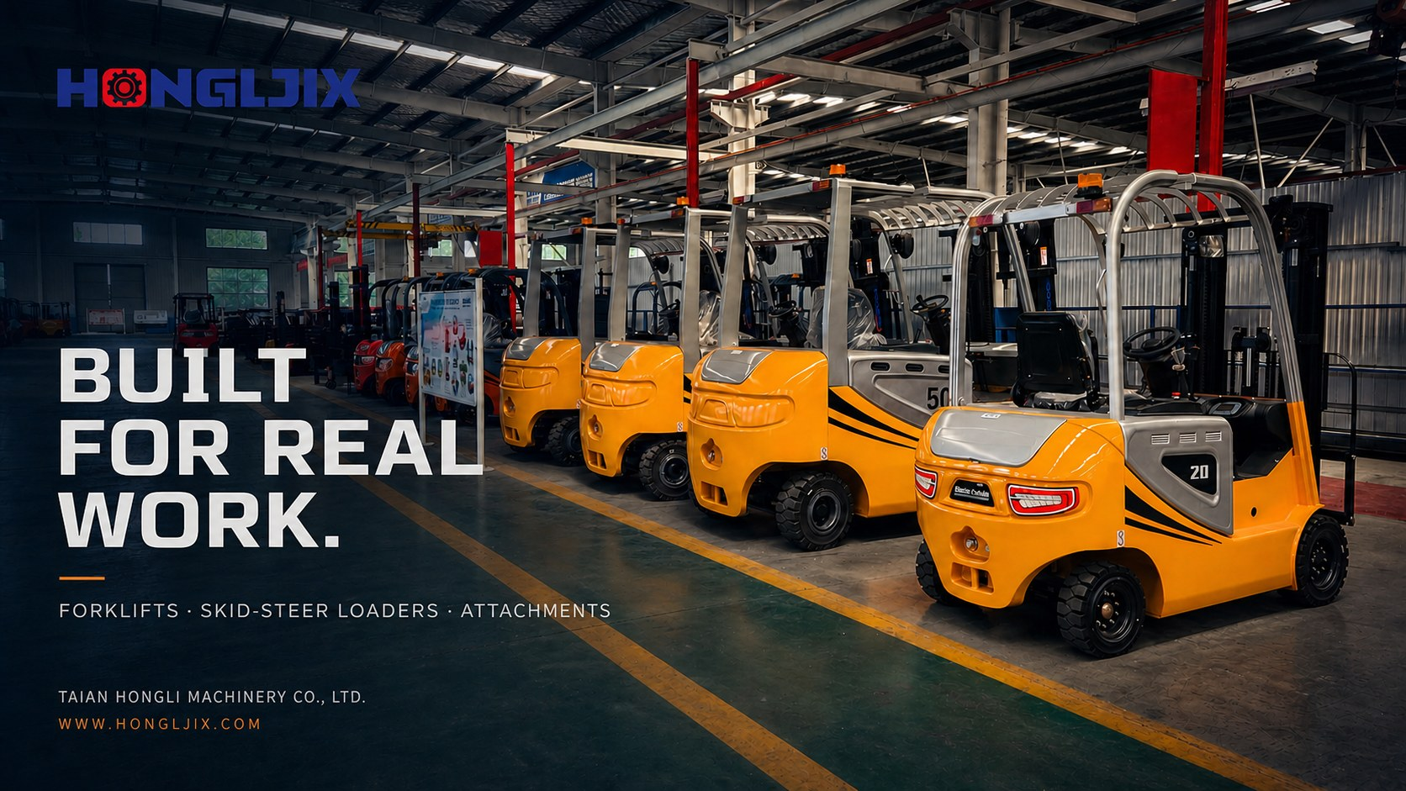

Slide 2


Slide 3
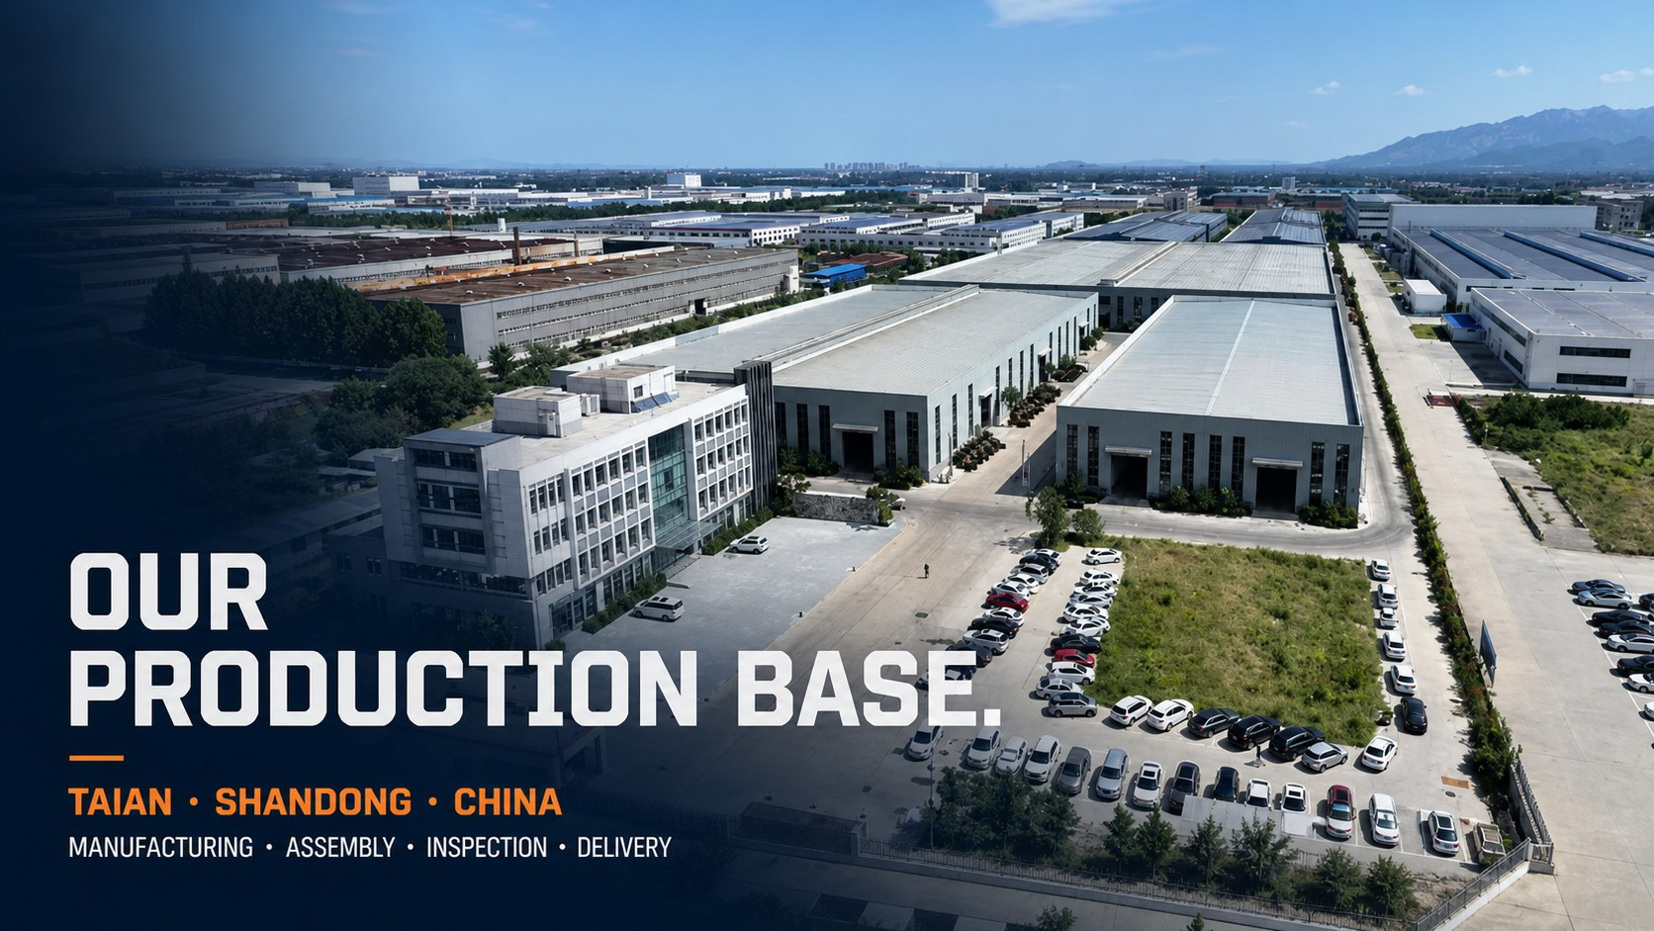
Notes:
[Sources]
- https://www.hongljix.com/assets/content/common/about-factory-campus.webp
[/Sources]

Slide 4


Slide 5
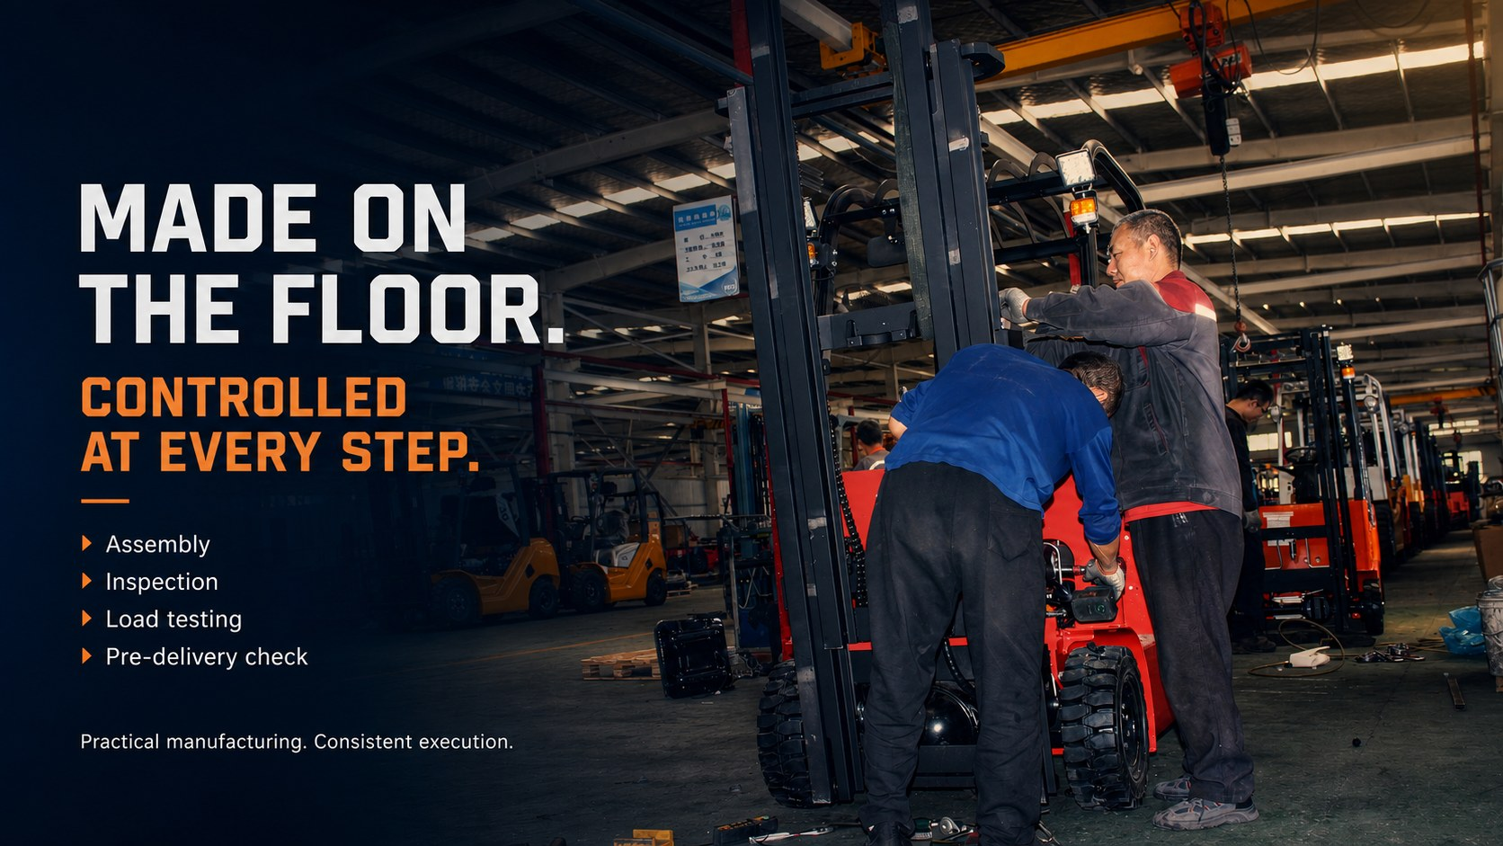

Slide 6
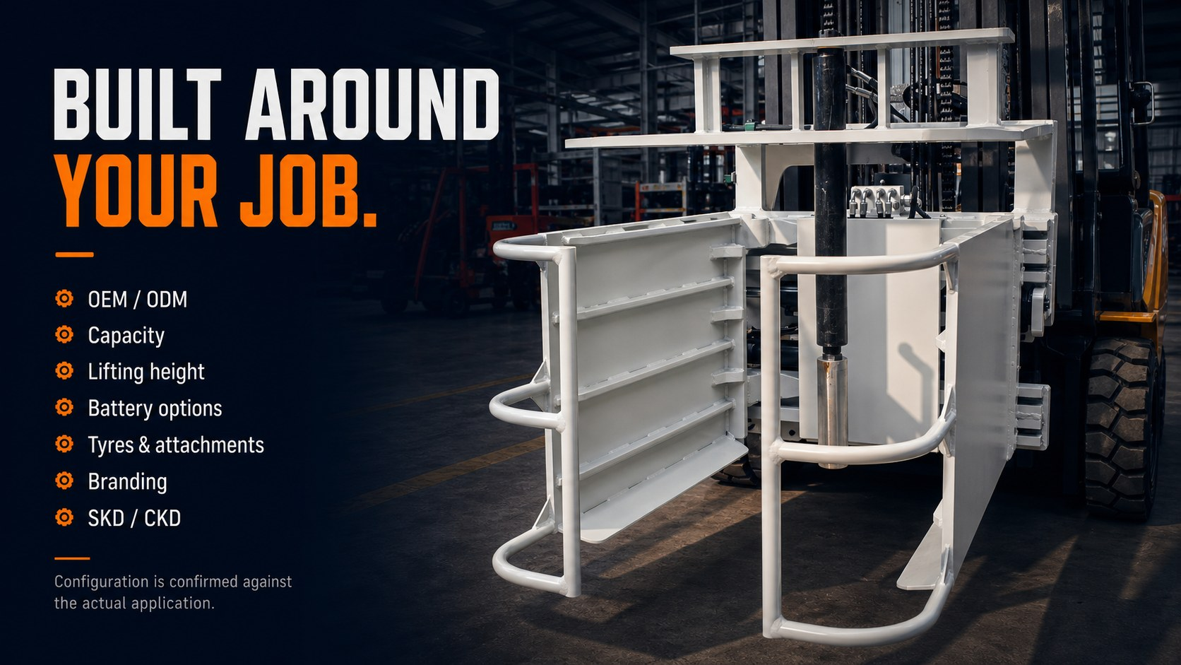

Slide 7


Slide 8


Slide 9
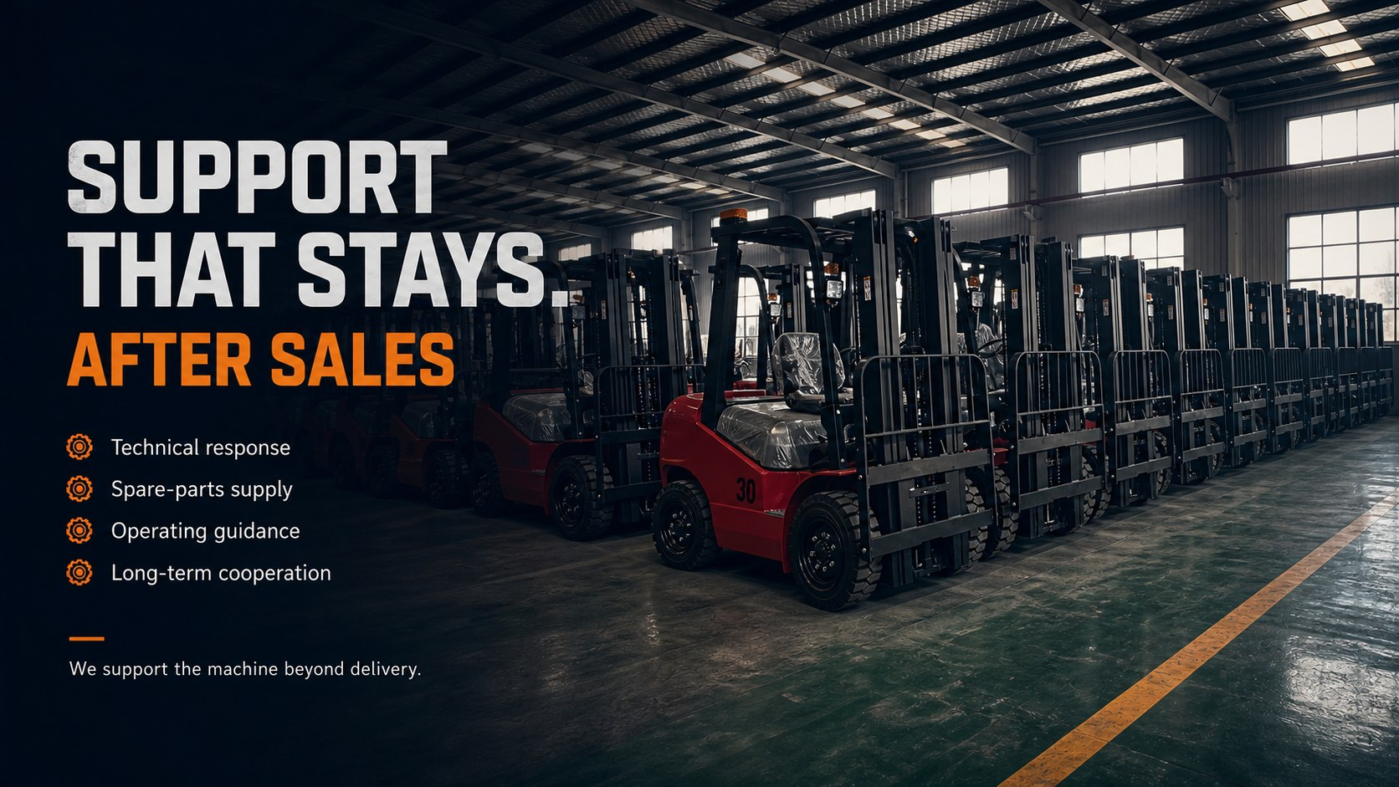

Slide 10


